Slide 1
CELL & MOLECULAR BIOLOGY FOR BIOINFORMATICS SEBB 4173 Chapter 2: DNA replication
Dr. Noor Hidayah

Slide 2
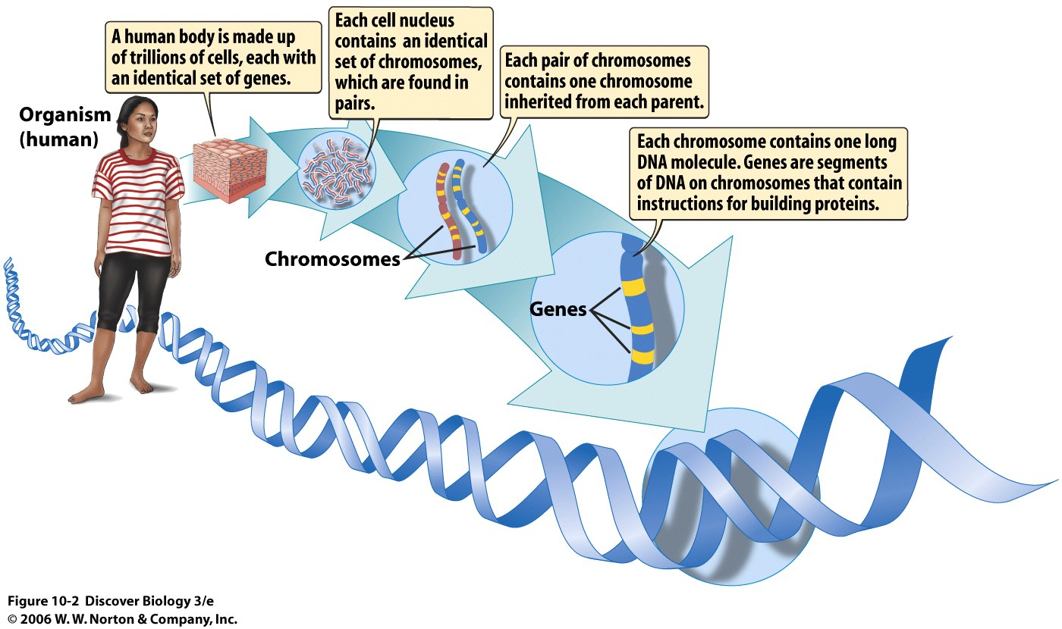

Slide 3
2.1 Gene
Gene: the unit of heredity.
Each gene is responsible for a single inherited property or characteristic of the organism (phenotype).
Since each cell needs a complete set of genes, it is necessary for the original cell to duplicate its genes before dividing.
Genes are made of DNA and make up the chromosomes, each chromosome must be accurately copied.
Upon cell division, both daughter cells will receive identical sets of chromosomes.

Slide 4
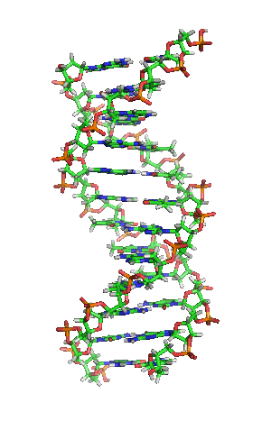
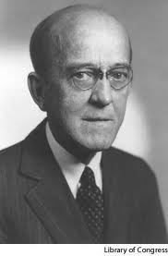
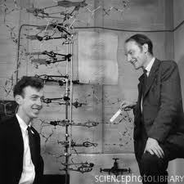
Experiments in the 1950s showed that DNA is the hereditary material.
Scientists raced to determine the structure of DNA.
1953 - Watson and Crick proposed that DNA is a double helix.

Slide 5
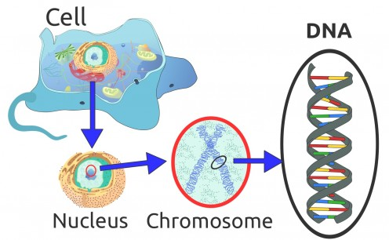
Where is DNA
Notes:
A gene is a section of a DNA molecule that codes for one particular protein.
The majority of a cell's DNA is located in the nucleus. DNA is combined with a small amount of protein to make chromosomes.

Slide 6
What is DNA?
Deoxyribonucleic acid, macromolecule known as a nucleic acid.
Double helix, composed of long strands of sugars-phosphate groups and nitrogenous bases (A-adenine, T-thymine, G-guanine, C-cytosine).
Adenine pairs with thymine (A-T) and guanine pairs with cytosine (G-C).
DNA is organized into structures called chromosomes and housed within the nucleus of our cells.
Notes:
A gene is a section of a DNA molecule that codes for one particular protein.

Slide 7
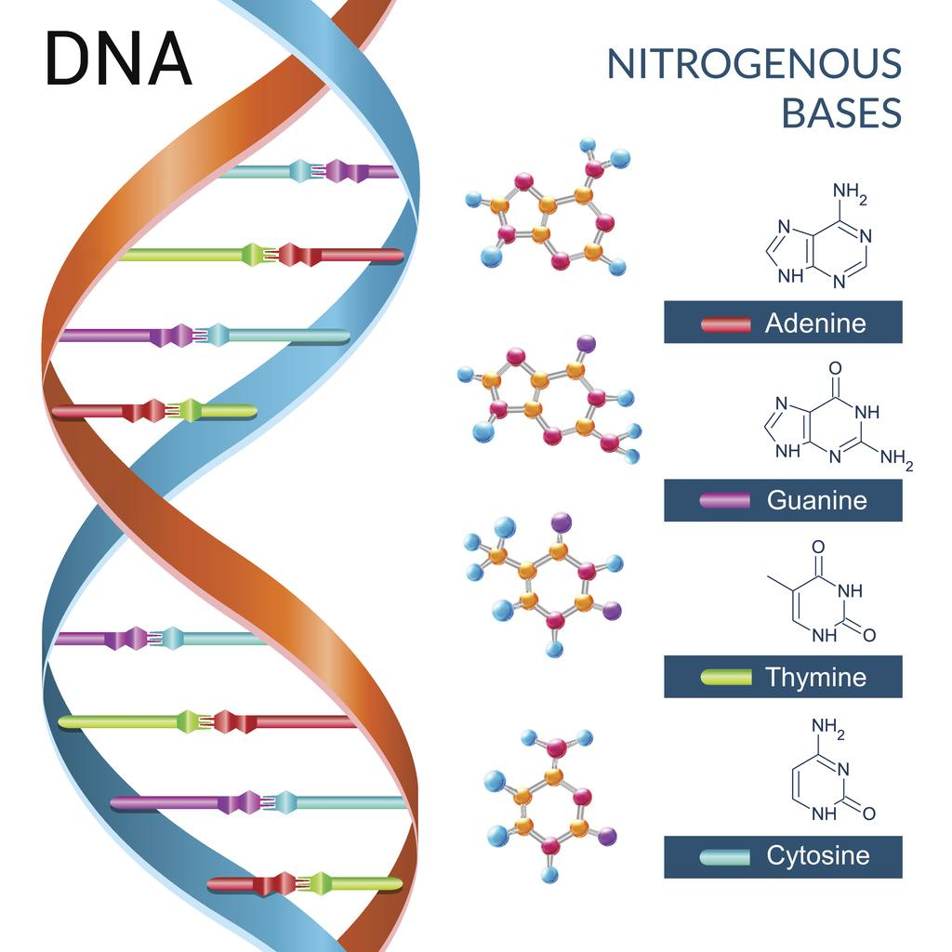

Slide 8
2.2 Replication of DNA
Replication = DNA of the original, or mother, is duplicated to give two identical copies.
Upon cell division, each of the descendants gets one complete copy of the DNA.
The original genes of the mother cell are on a double stranded DNA molecule.
Steps in DNA replication:
(1) Separation of the two strands of the DNA double helix.
(2) Building of a complementary strand on each of the two original strands.
DNA replication video

Slide 9
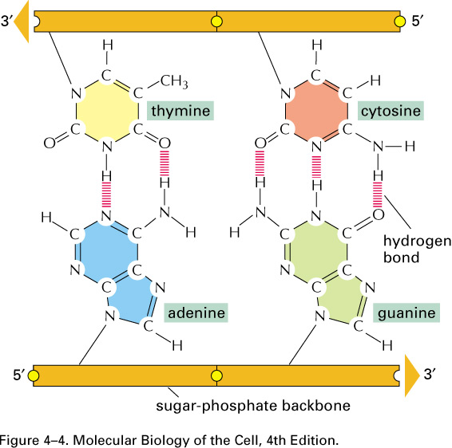
Since A only pairs with T, and G only pairs with C, the sequence of each strand dictates the sequence of its complementary strand.
A = T C = G
2 bonds
3 bonds

Slide 10
Two double stranded DNA molecules are produced, both with sequences identical to the original one.
One of these daughter molecules has the original left strand and the other daughter has the original right strand – semiconservative replication.

Slide 11
2.2.1 Semiconservative Replication
1
2
3
4
Parental strands
Parental strands separate
Parental strand receives new strand of DNA (1 set - one old and one new strand)
Strand 1 is identical to strand 3
Strand 2 is identical to strand 4
Strand 1 is complementary to strand 2
Strand 3 is complementary to strand 4

Slide 12
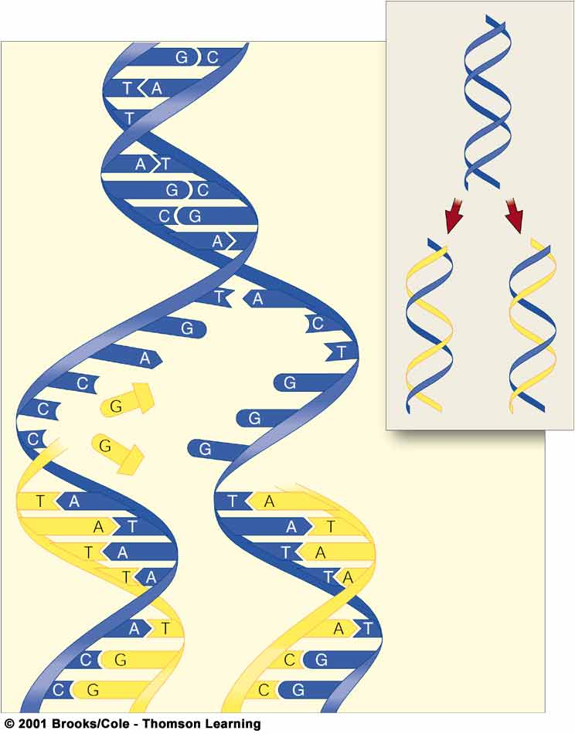
Each parent strand remains intact.
Every DNA molecule is half “old” and half “new”.

Slide 13
2.3 How are the new strands synthesised?

Slide 14
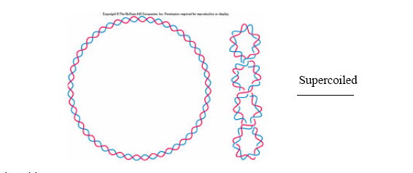
Separation of Double Helix into Strands
Because the two strands forming a DNA molecule are held together by hydrogen bonding and twisted around each other to form a double helix, they cannot simply be pulled apart.
The DNA inside a cell is also supercoiled to pack it into a small space. Before separating the strands, both the supercoils and the double helix must be unwound.

Slide 15
The unwinding process is done in two stages:
The supercoils are unwound by DNA gyrase (DNA topoisomerase). The gyrase cuts both strands of double stranded DNA to give a double stranded break.
Gyrase keeps hold of all of the cut ends. The two halves of the gyrase then rotate relative to each other and the ends are rejoined. This untwists the supercoils.
Each rotation costs the cell a small amount of energy.

Slide 16
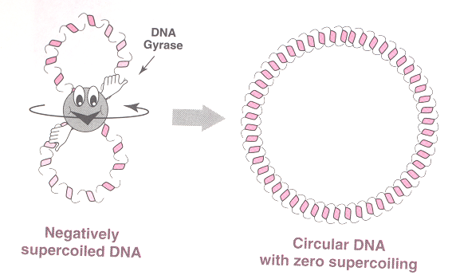
Action of DNA Gyrase
Double stranded breaks done by DNA gyrase will relieve supercoiling but will not pull the strands apart because the strands are still held by the hydrogen bonds between the bases. Once untwisted the ends are rejoined.

Slide 17
2. Then, the double helix is unwound by the enzyme DNA helicase.
Helicase does not break the DNA chain, it simply disrupts the hydrogen bonds holding the base pairs together.

Slide 18
The two original strands, despite their desire to cling together, must be kept apart.
This is done by a special "divorce" protein which binds to the unpaired single stranded DNA and prevents the two parental strands from getting back together.
Known as Single Strand Binding protein (SSB).

Slide 19
Making a New Strand of DNA
The critical issue in replication is the base pairing of A - T, G - C.
The incoming nucleotides for the new strand recognize their partners by base pairing and so are lined up on the template strand.

Slide 20
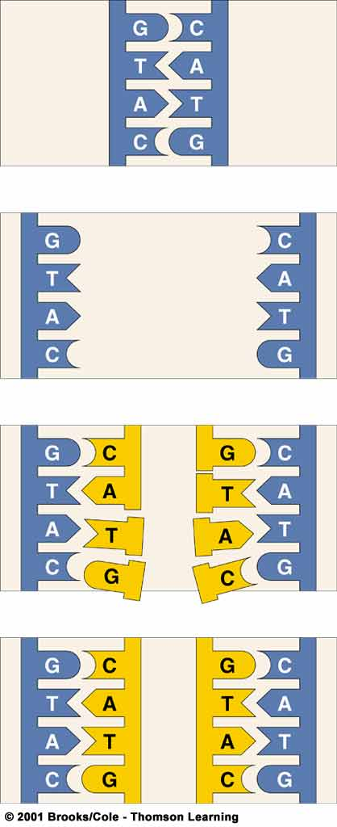
Base Pairing during Replication

Slide 21
How is this done?
Although hydrogen bonding alone would match bases correctly (99%) of the time this is not good enough.
The enzyme that links the nucleotides known as DNA polymerase III (pol III) can also sense if the bases are correctly paired.
If not, the mismatched base pair is rejected!

Slide 22
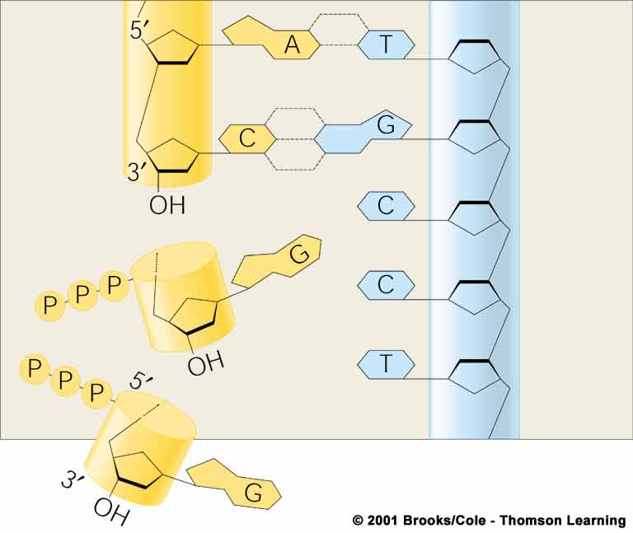
A Closer Look at Strand Assembly
Energy for strand assembly is provided by removal of two phosphate groups from free nucleotides

Slide 23
Synthesis Always Goes from 5' to 3’
Nucleotides have three components:
a phosphate group
a sugar molecule
the base.
In DNA the sugar is deoxyribose, and is joined to the base at position 1' and to the phosphate group at position 5'.
The carbon atoms of the deoxyribose sugar are numbered with prime marks (1‘, 2’, 3’…) to distinguish them from those of the base which have plain numbers (1, 2, 3…).

Slide 24
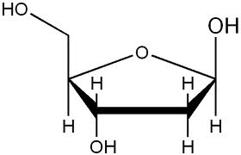
TRIPHOSPHATE-
5’
-BASE
4’
1’
3’
2’
Next nucleotide is joined here

Slide 25
Since A only pairs with T, and G only pairs with C, the sequence of each strand dictates the sequence of its complementary strand.
A = T C = G
2 bonds
3 bonds

Slide 26
Direction of DNA Synthesis
New DNA strands always start at the 5’ end and grow in the 3’ direction.
DNA is normally double stranded, and it happens that the two strands run in opposite directions (if one goes 5' to 3' then its complementary partner will run from 3' to 5’)
The strands are said to be anti-parallel.

Slide 27
The Replication Fork Is Where the Action Is!
The replication fork = the total structure in the region where the DNA molecule is being duplicated.
Includes:
the swivel where the DNA is being twisted by DNA gyrase,
the helicase following right behind, and
the stretches of single stranded DNA held apart by the SSBs.
Also has two molecules of pol III which are busy making two new strands of DNA. The two new strands must be synthesised in opposite directions.

Slide 28
The Replication Fork
3’
5’
SSB
DNA helicase
3’
5’
5’
3’
3’
5’
3’
5’

Slide 29
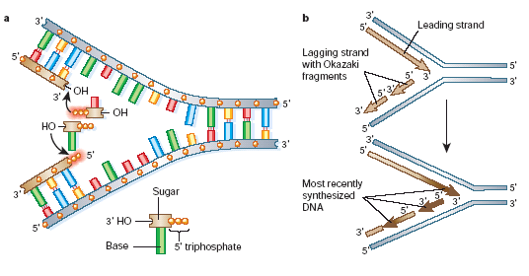

Slide 30
Completing the Lagging Strand
The leading strand just keeps getting longer and longer, but the lagging strand is left as a series of short pieces with gaps in between after the replication fork has passed by.
Okazaki fragments - must be joined together to give a complete strand of DNA.
The completion of lagging strand requires two enzymes: DNA polymerase I and DNA ligase.
Polymerase I fills in the gaps.
Ligase joins the gaps.

Slide 31
Starting a New Strand
Although the leading strand only needs to be started once, the lagging strand is made in short sections and we need to start again every time we make a new Okazaki fragment.
DNA pol cannot start a new strand by itself, it can only elongate.

Slide 32
New strands are started with short stretch, not of DNA itself, but of RNA primers.
Primase makes the RNA primers.
Primase lays down a short RNA primer, before DNA polymerase elongates the strand.
The RNA primer is then removed, and replaced with DNA, before replication completes.
Notes:
Primer is removed by Pol I.

Slide 33
DNA pol I was discovered before DNA pol III.
Both of the enzymes have important use in genetic engineering.

Slide 34
GAP
OKAZAKI FRAGMENT
Gap in lagging
strand
3’
5’
5’
3’
Original DNA strand
Direction of synthesis
DNA Pol 1
3’
Pol I Fills Gap with nucleotides
5’
Newly added nucleotides
5’
3’
New 5’-3’ bond
‘Nick’ Remains
One ‘nick’ remains
3’
5’
5’
3’
DNA
ligase
Differentiate GAP and NICK!
Ligase seals nick
3’
5’
5’
3’

Slide 35
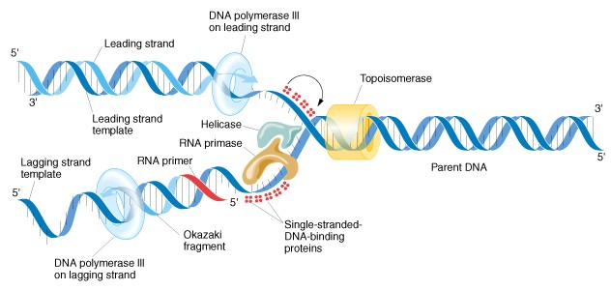
Recoiling the DNA into a Helix
Once the replication fork has moved past, the double stranded DNA molecule automatically rewinds into a helix.
http://kimwootae.com.ne.kr/apbiology/chap10.htm

Slide 36

End of Chapter 2!

